Slide 1
Key words
Capacitance
Charging a capacitor
In parallel
In series
Equivalent capacitance
Energy density
Polar dielectrics
Nonpolar dielectrics
Induced surface charges

Slide 2
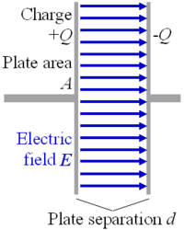


Capacitance
q is not the total charge
V is ∆V

Slide 3
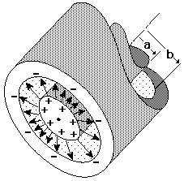

Capacitance
q is not the total charge
V is ∆V

Slide 4
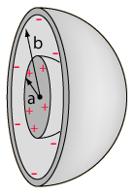

Capacitance
q is not the total charge
V is ∆V

Slide 5
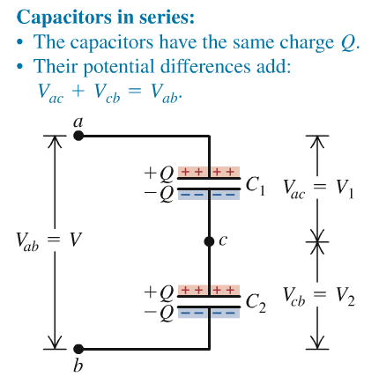


Capacitor in series / parallel connection

Slide 6
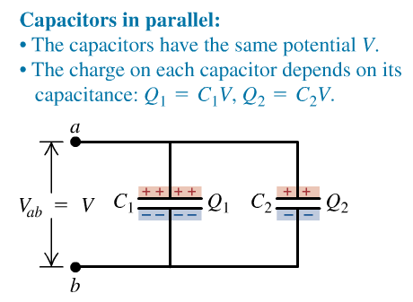

Capacitor in series / parallel connection

Slide 7




Electric field energy / Electric energy density

Slide 8
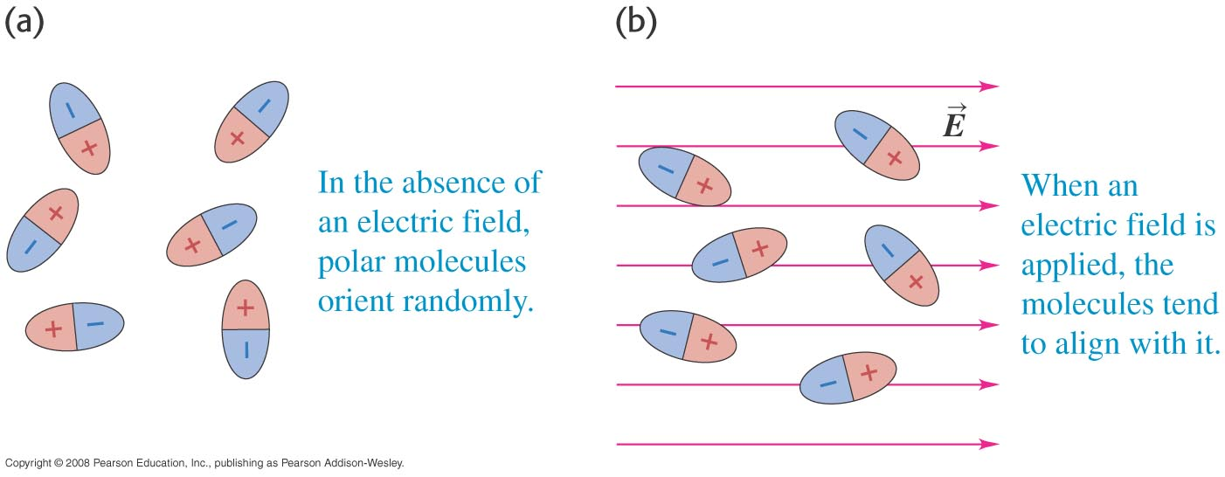
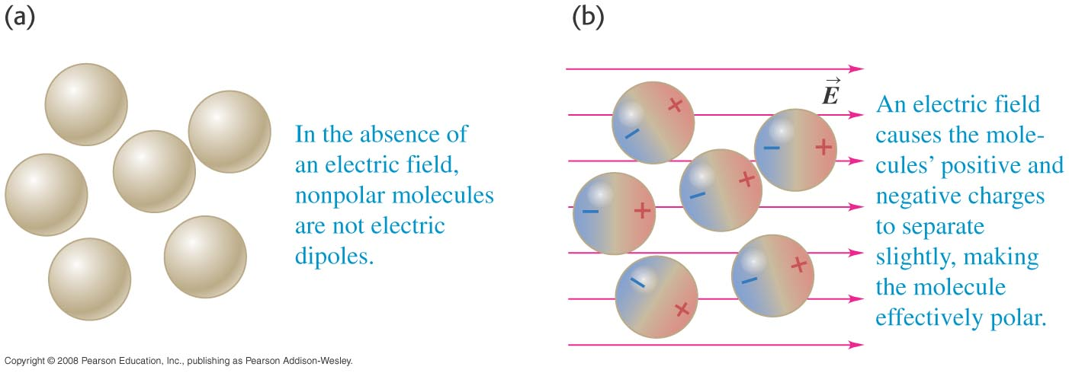
Molecular model of induced charge
polar molecules
nonpolar molecules

Slide 9
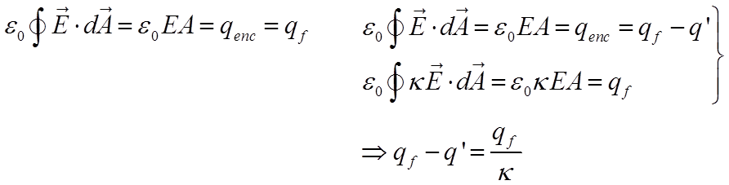
Dielectric and Gauss’ Law
Notes:
Without dielectric, only free charge is involved, so gauss’s law is
With dielectric, we know on the top and bottom surfaces of the dielectric have induced charge which can decrease the original E field, because involving the free charge and induced charge, the gauss’s law can be written as this：
We use k to describe the ability of the dielectric to weak the original E field, let the right side of gauss’s law only involving free charge, the gauss’s law is also can be written as:
The induced surface charge have been taken fully into account by this k.
Compare to these two equation, we can get this relation between free charge and induced charge.

Slide 10
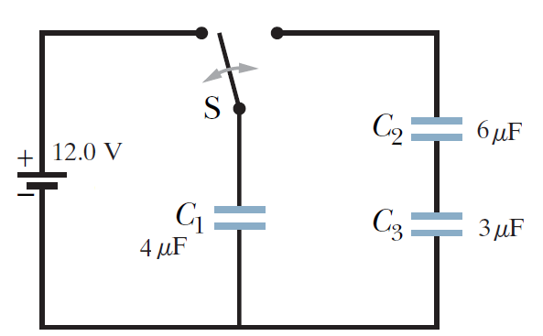
Question 1
Switch is thrown to the left side until C₁ is fully charged. Then
the switch is thrown to the right.
16.0 V
What is the final charge on C₁ , C₂ and C₃ ?

Slide 11

Answer:
(a) Solving the two equations
for q₁ and q₂, we obtain
q₁ = 42.7
(b) The charge on capacitors 2 is
(c) The charge on capacitor 3 is the same as that on capacitor 2:

Slide 12
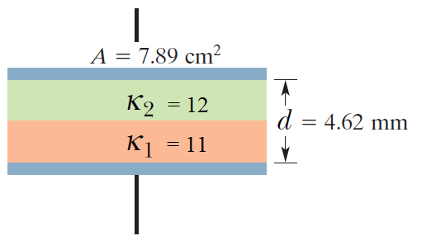
Question 2
Capacitance?

Slide 13




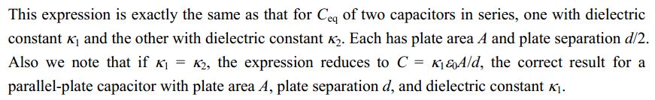
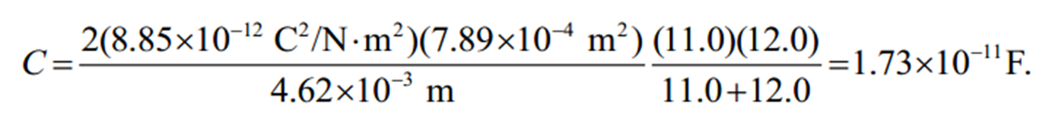
Answer:

Slide 14
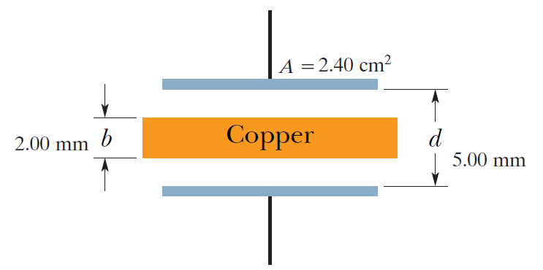
Question 3
Copper is introduced to the isolated capacitor
Capacitance with the copper introduced?
If q = 3.4 μC is on the plates, what is the ratio of the stored energy before to that after the copper is inserted? (i.e. U_{before} : U_{after} )
How much work is done on the copper as it is inserted?
Is the copper sucked in or pushed in?

Slide 15
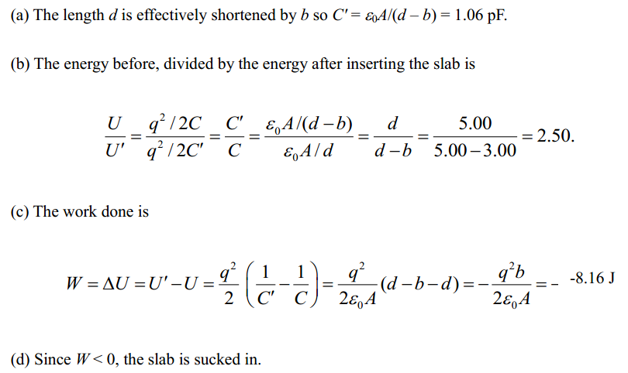
Answer:
0.708pF
5.44J

Slide 16
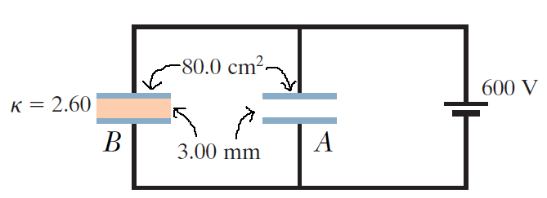
Question 4
Find
E-field in the dielectric of capacitor B
E-field in capacitor A
Free charge density σon the higher potential plate of capacitor A and capacitor B
What is the induced charge density σ’ on the top surface of the dielectric?

Slide 17
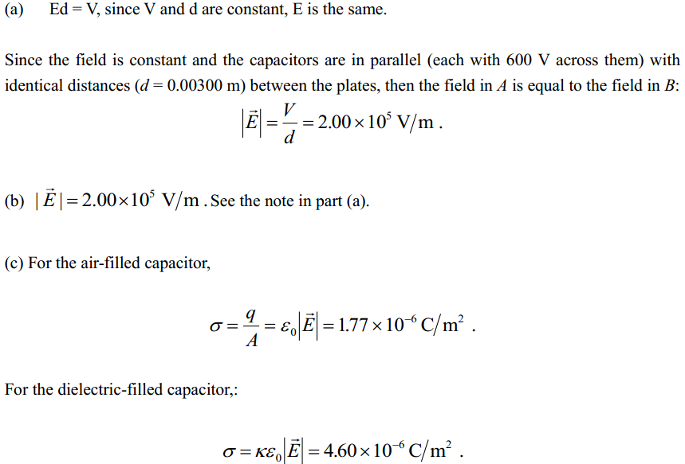
Answer:

Slide 18
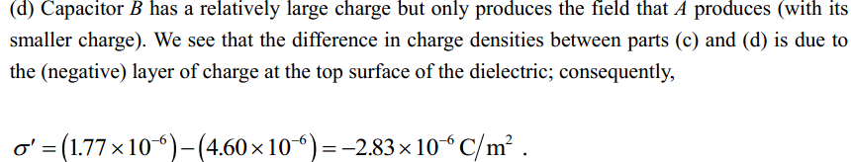
Answer:

